Slide 1
ADA National Network Learning Session
January 10, 2019
Disability Integration Throughout the Disaster Cycle
The latest in American Red Cross efforts to include people with disabilities in emergency planning and response

Slide 2
Presentation Objectives
Review Disability Integration definitions and philosophies
Define Planning for Accommodating Access and Functional Needs in Congregate Shelters
Outline Red Cross Sheltering Program and Disability Integration
Highlight Response Best Practices and Resources
2
Notes:
Review objectives
We will very quickly review current guidance and information about the concepts of providing FNSS and direct you to both governmental and Red Cross directives and resource materials
We will engage you in discussions aimed at heightening your awareness and thinking about the sheltering environment, how residents can prepare themselves to function in that environment and to express their needs, and how to best serve the needs of those who have specific access or functional support needs.
We will look at some tools and resources available to help us better address these needs.

Slide 3
FEMA Definition of Functional Needs Support Services
Individuals requiring Functional Needs Support Services may have physical, sensory, mental health, cognitive and/or intellectual disabilities affecting their ability to function independently without assistance
3
Notes:
In the aftermath of several catastrophic level disasters at the beginning of the 21st century, sheltering was put to extreme tests. These included:
the 2001 World Trade Center attack,
massive flooding over the whole midwest in 2003
the 2004 quadruple hurricane strikes on Florida
the 2005 back-to-back Hurricanes Katrina, Rita and Wilma –
Red Cross served more people in more shelters over that 5-year period than ever before, and thousands of spontaneous volunteers were pressed into service. Hundreds of independent “Good Samaritan”, non-Red Cross shelters were opened.
Resources were pressed to the limit in every case and gaps in planning and service delivery resources became glaringly apparent, particularly for people who had functional and access needs, often as a result of some type of disability. As a result, new guidance was issued by FEMA and Red Cross did an intensive re-focus on this aspect of shelter planning and service delivery and added more emphasis on the topic in all shelter training -- including re-training of all shelter workers.
This definition of FNSS is used in orienting Red Cross shelter workers and is included in the newly revised Red Cross shelter operations training. These concepts have been provided as a separate workshop to all shelter staff since late 2010 until the training materials were updated. The concepts of inclusion were already a part of Red Cross training and policy – they were part of the initial shelter training I had over 30 years ago - but may not have had as much emphasis or consistent application at every level, particularly among less experienced staff.

Slide 4
Access and Functional Needs are Universal
Access and functional needs are met thru the provision of physical, programmatic and effective communication access to the whole community, accommodating individual requirements through universal accessibility and/or specific actions or modifications. This includes assistance, accommodation or modification for mobility, communication, transportation, safety, health, health maintenance, or any situation which limits an individual’s ability to take action in an emergency.
4
Notes:
Just to be sure we’re all on the same page, let’s describe the range of areas in which people can have functional needs:
Physical – people with mobility issues – spinal cord injuries, amputation, cerebral palsy
Sensory – diminished vision and hearing, or a changes in sensation in hands and feet
Mental health – depression, Schizophrenia, bi-polar disorder, autism
Cognitive/Intellectual – developmental delay, dyslexia, attention deficit disorder, brain injury

Slide 5
5

Slide 6
Medical Needs Versus Access and Functional Needs
Functional needs do not equate to a “medical” condition and do not require a medical shelter
Placement in medical shelters can result in separation from family, friends, neighbors and caregivers
Can jeopardize the health and safety of the entire community by creating unnecessary surges on emergency medical resources
6

Slide 7
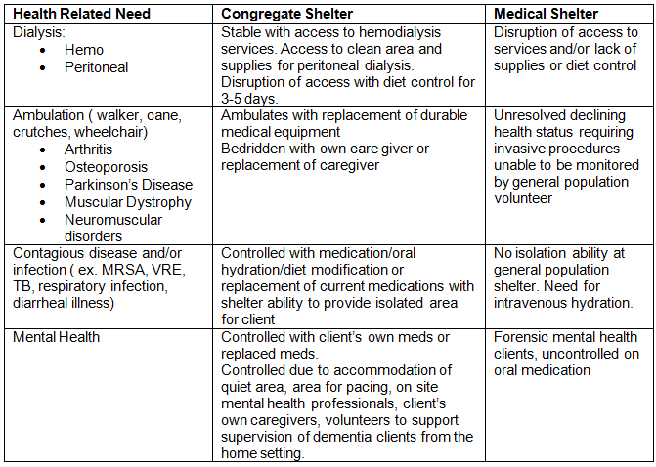
Health Needs Accommodated in a Congregate Population Shelter
7

Slide 8
Addressing Functional Needs Support Services (FNSS)
Identify durable medical equipment suppliers to procure mobility equipment
Partner with a free loaner source: hospital beds, bedside commodes
Purchase transfer boards for shelter trailers
Locate sources for ASL and foreign language interpreting
Prepare communication in a variety of formats
8

Slide 9
Examples of Accommodation
Modify kitchen access for people with medical conditions requiring access to food outside the usual meal times; provide for unique dietary requirements
Provide way-finding assistance to those with low vision
Provide assistive technology for visual, non-verbal or non-English communicators
Provide quiet space for those who need it
9

Slide 10
Community Planning
Review Current Plans
Identify Stakeholders
Community Gap Analysis
Identify Resources & Establish Relationships
10
Notes:
The planning process involves:
Reviewing and updating existing plans
Identifying and engaging all community stakeholders in sheltering issues
Analyzing community preparedness and identifying gaps in planning
Identifying resources to address the gaps and establishing relationships and agreements to obtain those resources – both human and material
Communities are all different and in varying phases of planning for functional and access needs.
BUT A good place to start community planning is by reviewing existing “special needs plans” and integrating appropriate components into of those plans into general population sheltering plan.
Planning will require “thinking outside the box” and engaging the insights and skills of consumer groups and advocacy groups in addition to those of the usual disaster responders.

Slide 11
Shelter Planning
Think broadly when planning for shelter accessibility
Include community members with disabilities and other access and functional needs
Accessibility gaps may need to be identified during planning and addressed at time of disaster
11
Notes:
When Red Cross is requested to support sheltering, it’s our role to determine whether we can provide emergency services in a designated facility which are accessible to people with disabilities and others with access and functional needs. We are currently building into our new Operational Sheltering System the Department of Justice ADA Emergency Shelter Checklist. It provides a comprehensive survey and picture of a facility’s accessibility and any modifications which may be necessary to accommodate all shelter residents.
Staff of local Centers for Independent Living and Protection & Advocacy agencies, city/county ADA Coordinators and other disability community stakeholders are good partners for assistance with shelter assessment and advocacy with government partners for better shelter selection.
Accessibility is required in the following areas:
Parking and drop-off zones
At least one entrance
Routes to all service delivery areas: Registration, Dormitory, Feeding, HS/DMH, Recreation
Restrooms (both stalls and overall navigability)
Community plan should detail who is responsible for providing modifications when necessary.

Slide 12
Red Cross Sheltering Philosophy
Shelters must be, first and foremost, places of comfort and safety which accommodate the broadest range of needs in the least restrictive setting for all clients
Shelters must be accessible to those affected
Shelter workers and managers must be strong advocates for their clients
Clients must be supported and empowered to remain independent, proactive participants in their own recovery
12
Notes:
Serving people with disabilities is not only a Red Cross resolution – it’s part of the fundamental principles of Humanity and Impartiality that under gird all Red Cross service delivery as part of our international charter.
We look at the Federal FNSS guidance as a positive means of providing quality service delivery for our clients and for clarifying expectations.
Our approach is to do the very best we can, under emergency conditions, to accommodate people with functional needs in our shelters. While we need to plan to have the skills, staff, equipment and supplies available, it does NOT mean that Red Cross is doing this all by ourselves – we need to work with a variety of other organizations and individuals and involve the Whole Community in the planning effort to meet the needs of the Whole Community.
It may also mean that not all equipment, supplies or services will be available at all shelters immediately. While we have some limited stashes of durable medical equipment and other supplies, we may not have enough in every location at the beginning of the event. We may have to locate additional supplies in the local community that can be borrowed until supplies can be moved from field warehouses or from one site to another.
It is the responsibility of local planners to identify sources of equipment, supplies and services that can be obtained until national resources can be obtained. We’ll talk more about that in a few minutes.

Slide 13
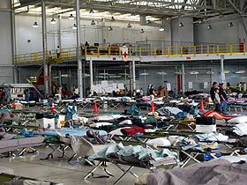
Shelter Layout
Place cots so that routes are accessible to people who use mobility devices
Allow extra space for people who use mobility devices, lift equipment, service animals – up to 100 square feet
13
Notes:
Numbers are from Mass Care Standards and Indicators, developed by NVOAD Mass Care committee, which Red Cross currently chairs.
When designing the shelter floor plan, there are a number of factors to consider:
Ensure that routes are accessible to all service areas including bathrooms, dining and recreation areas, and to health and mental health service areas. Be sure those with visual impairments are aware of changes in floor plans and all walkways are clear of obstructions.
Allow extra space for the use of mobility devices, such as wheelchairs, canes, motorized scooters
While there may be lift equipment in the shelter, we do not expect Red Cross workers to be operating it. If they need help with locating resources or trained assistants, Health Services should be contacted.
Older adults may need to have low light available even at night or need to be located closer to bathrooms if they have to get up during the night.
Residents who are easily disturbed and agitated by the usual shelter noises and activity may need to be located in quieter areas, or have a quiet space created for them. This may include privacy screens or dividers (blue walls), tents or “pop-up” covers for cots.

Slide 14
Red Cross Process for Understanding Client Needs
Identify and address individual client needs
Use Registration Intake form to document needs and potential barriers to recovery
Assist individuals in maintaining their usual level of independence and supporting their right to self-determination
14

Slide 15
CMIST – A Functional Framework
Communication
Maintaining Health
Independence
Safety, Security and Self-Determination
Transportation
15
Notes:
Let’s move on to how we understand access and functional needs. A way to do this is by using a model called CMIST. This model will help you understand the access and functional needs of individuals. The reason for using the CMIST model is to place the shelter community into an independent living model instead of a medical model.
The CMIST model provides a functional needs framework which assists workers with gathering and organizing information about a client’s self-identified access and functional needs. This framework supports the independence and self-determination of all clients and, for individuals with disabilities, discourages the medical model approach which tends to view them as patients.
Let’s go through the CMIST components:
The first component is Communication. Communication has many facets and when deciding how to best communicate with clients, you need to take into account the following disabilities or access and functional needs:
Low vision or a hearing loss
Cognitive or developmental disabilities, which make it difficult for them to process information
English as their second language
Other alternate messaging needs, such as picture boards, technical aids, etc.
The second component is Maintaining Health. To maintain health of the clients, the following should be considered:
Does the client have acute or chronic health issues?
Does the client need medication support?
Does the client identify as being pregnant?
Does the client share that they need a private area for support for catheterization, wound care or colostomy care?
Does the client share that they need dietary or allergy support?
Does the client or family member ask about access to a quiet area?
The third component is Independence. Being independent is what we all want, but for some, additional support is needed to maintain independence. Go through the following list as you assist individuals and support their independence:
Does the shelter resident need support to maintain their independence (for example, has a caregiver, needs help with a wheelchair or with activities of daily living?)
Observe if the shelter resident has a service animal.
The person’s needs may include durable medical equipment needs, assistive technology, physical access and/or assistance to all services.
The fourth component is Services, Support and Self-determination.
Some examples may include:
Persons who have lost caregivers or whose condition changes within the context of evacuation or displacement, causing needs that require more direct support.
Think about the needs of an elderly shelter resident with early dementia. Does the family or caregiver need respite or assistance with monitoring the family member with early dementia?
Does a family need a quiet area for a child or adult family member with autism, sensory disorders or anxiety?
Self-determination for clients may not make you feel comfortable. You may feel that your decisions are best for the client, but clients need to make their own decisions even if we think the decision is not in their best interest.
The final component is Transportation. Having the means to get around the community to get to work or to appointments is an important aspect of independent living. It’s up to you to assist those that may need transportation to dialysis, physical therapy, or physician appointments. It’s imperative that your region familiarize itself with the community's plan for transportation after a disaster, and be a facilitative leader in developing more robust transportation plans.

Slide 16
Most Common Needs
Prescription refills
Consumable Medical Supplies
Access to health & dental care
Specific dietary requirements
Mobility issues
Personal care assistance
Assistance with vision & hearing, such as glasses or hearing aids
16

Slide 17
Additional Most Common Needs
Language interpreters
American Sign Language
Spanish
Russian
Getting to appointments
Getting to needed daily treatments
17

Slide 18
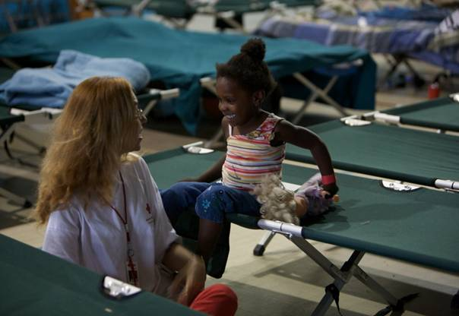
Most Common Needs
Assistive equipment
Dining, sleeping and shower assistance
Access to community partners
Childcare
Keeping families together
Shelter spacing needs
18

Slide 19
Planning Key Considerations
Planning and responding with partners
Functional Needs Support Services Guidance does not require stockpiling supplies, but the ability to secure resources when needed
Include Functional Needs Support Services at all phases of the disaster cycle
Train and deploy a diverse and inclusive workforce
19

Slide 20
Other Planning Key Considerations
Exercise and evaluate your integrated community plan with real people
Interact with your community to learn about potential access and functional needs
Plan inclusively to meet the needs of the whole community
20

Slide 21
Response Key Considerations
Assess shelter and other service delivery sites for accessibility and make any necessary modifications
Evaluate programs and services for accessibility, including effective communication measures such as on-demand language interpreters and varying types of communication devices
Ask what assistance the client needs
Be flexible and innovative
Make safety a priority
21

Slide 22
Red Cross Process
National Disability Integration Coordinator
Infrastructure : Divisional and Regional Disability Integration advisors
Formal and informal partnerships with disability community stakeholders and organizations
22

Slide 23
Red Cross Training
Just in Time training
Inclusive language and integration woven throughout all Mass Care training
Disaster Institute presentations
In development: Disability Integration Fundamentals, including exploration of the ADA and its application in Disaster Response
23

Slide 24
Best Practices in Response
National MOU partnership with NDRN and collaboration between P&A agencies and Red Cross to identify and resolve accessibility issues in shelters
Local collaboration with Centers for Independent Living and other stakeholder organizations to meet immediate needs, distribute emergency supplies, and facilitate short and long term recovery
24

Slide 25
Additional Response Best Practices
Rapid deployment of Disability Integration, Disaster Health Services and Disaster Mental Health leadership and workers to support Mass Care
Immediate set-up of video phones and VRI app-enabled laptops in shelters
Distribution of sensory kits to children and adults needing support to cope with the shelter environment
25
Notes:
In the last half of 2018, Red Cross deployed 4 Deaf volunteers, as well as both volunteer and paid registered American Sign Language interpreters to support them and Deaf disaster survivors in our shelters and within disaster-affected communities. In Florida after Hurricane Michael, we conducted outreach to 15 individuals and family groups in the Deaf community. In the aftermath of the Camp Fire in California, we have provided ongoing support to 6 Deaf individuals and family groups in our shelters.
Over the course of our 2018 disaster responses, we had 90 Video Phone app-equipped laptops and 30 mobile Video Phones ready for use in our shelters, family assistance centers and multi-agency resource centers. This equipment was in constant rotation as shelters and other service delivery centers closed and new ones opened, maxing out at 60 total in use at any given time. We also provided access to 5 news outlets for the Deaf and Hard-of-Hearing, and 3 for clients who are blind or have low vision. This included Sign1, a CNN service.
Over the major disasters in the last half of 2018, we distributed to clients in shelters and affected communities over 100 sensory kits, consisting of a weighted blanket, noise-reducing headphones and a stress ball for manual release of tension.

Slide 26
Resources
Guidance on Planning for Integration of Functional Needs Support Services in General Population Shelters http://www.fema.gov/pdf/about/odic/fnss_guidance.pdf
Tips for First Responders 5th Edition: http://cdd.unm.edu/dhpd/pdfs/FifthEditionTipssheet.pdf
Children in Disasters http://www.cdc.gov/childrenindisasters/
Infant feeding in disasters http://www2.aap.org/breastfeeding/files/pdf/infantnutritiondisaster.pdf
26

Slide 27
Questions/Discussion
27

Slide 28
Contact
Mary Casey-Lockyer
Mary.caseylockyer@redcross.org
Shari Myers
Shari.Myers2@redcross.org
28

